Slide 1
Support Vector Machines

Slide 2
History of SVM
SVM is related to statistical learning theory [3]
SVM was first introduced in 1992 [1]
SVM becomes popular because of its success in handwritten digit recognition
  1.1% test error rate for SVM. This is the same as the error rates of a carefully constructed neural network, LeNet 4.
    See Section 5.11 in [2] or the discussion in [3] for details
SVM is now regarded as an important example of “kernel methods”, one of the key area in machine learning
[1] B.E. Boser et al. A Training Algorithm for Optimal Margin Classifiers. Proceedings of the Fifth Annual Workshop on Computational Learning Theory 5 144-152, Pittsburgh, 1992.
[2] L. Bottou et al. Comparison of classifier methods: a case study in handwritten digit recognition. Proceedings of the 12th IAPR International Conference on Pattern Recognition, vol. 2, pp. 77-82.
[3] V. Vapnik. The Nature of Statistical Learning Theory. 2nd edition, Springer, 1999.
Notes:
First introduced in COLT-92 by Boser, Guyon and Vapnik
COLT = computational learning theory
B. Scholkopf et al. ICANN 96. 47-52.

Slide 3
What is a good Decision Boundary?
Consider a two-class, linearly separable classification problem
Many decision boundaries!
  The Perceptron algorithm can be used to find such a boundary
  Different algorithms have been proposed
Are all decision boundaries equally good?
Class 2
Class 1
Notes:
Perceptron learning rule can be used to find any decision boundary between class 1 and class 2

Slide 4
Linear Classifiers
α
x
f
y^{est}
f(x,w,b) = sign(w. x + b)
denotes +1
denotes -1
Any of these would be fine..
..but which is best?

Slide 5
Examples of Bad Decision Boundaries
Class 2
Class 2
Class 1
Class 1

Slide 6
Classifier Margin
α
x
f
y^{est}
f(x,w,b) = sign(w. x + b)
denotes +1
denotes -1
Define the margin of a linear classifier as the width that the boundary could be increased by before hitting a datapoint.

Slide 7
Maximum Margin
α
x
f
y^{est}
f(x,w,b) = sign(w. x + b)
denotes +1
denotes -1
The maximum margin linear classifier is the linear classifier with the, um, maximum margin.
This is the simplest kind of SVM (Called an LSVM)
Linear SVM

Slide 8
Maximum Margin
α
x
f
y^{est}
f(x,w,b) = sign(w. x - b)
denotes +1
denotes -1
The maximum margin linear classifier is the linear classifier with the, um, maximum margin.
This is the simplest kind of SVM (Called an LSVM)
Support Vectors are those datapoints that the margin pushes up against
Linear SVM

Slide 9
Why Maximum Margin?
Intuitively this feels safest.
If we’ve made a small error in the location of the boundary (it’s been jolted in its perpendicular direction) this gives us least chance of causing a misclassification.
LOOCV is easy since the model is immune to removal of any non-support-vector datapoints.
There’s some theory (using VC dimension) that is related to (but not the same as) the proposition that this is a good thing.
Empirically it works very very well.
f(x,w,b) = sign(w. x - b)
denotes +1
denotes -1
The maximum margin linear classifier is the linear classifier with the, um, maximum margin.
This is the simplest kind of SVM (Called an LSVM)
Support Vectors are those datapoints that the margin pushes up against

Slide 10

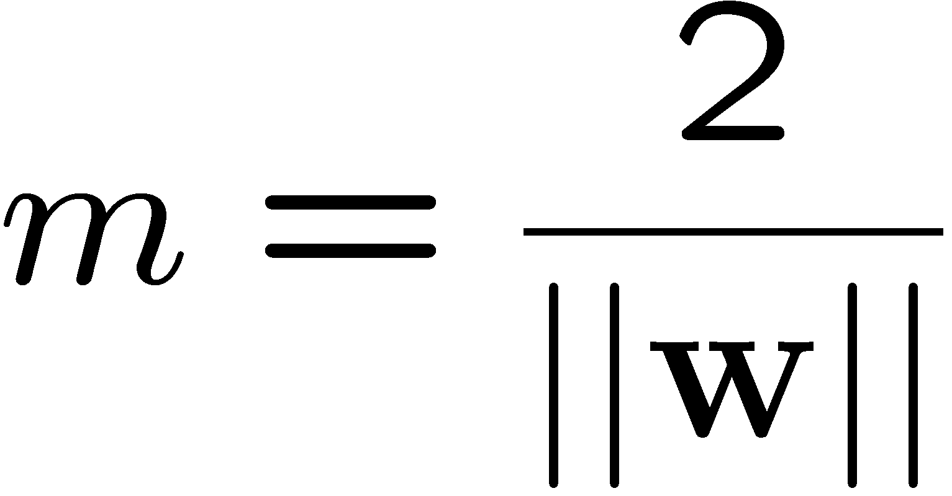
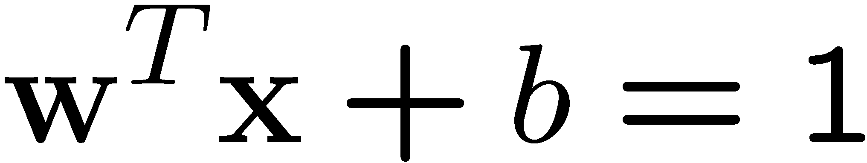
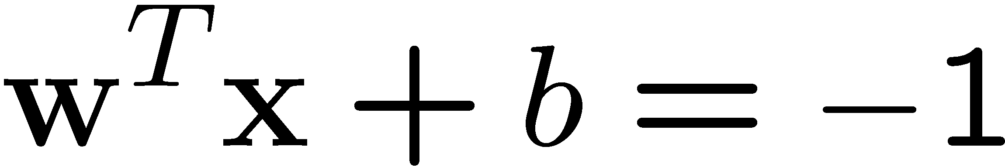
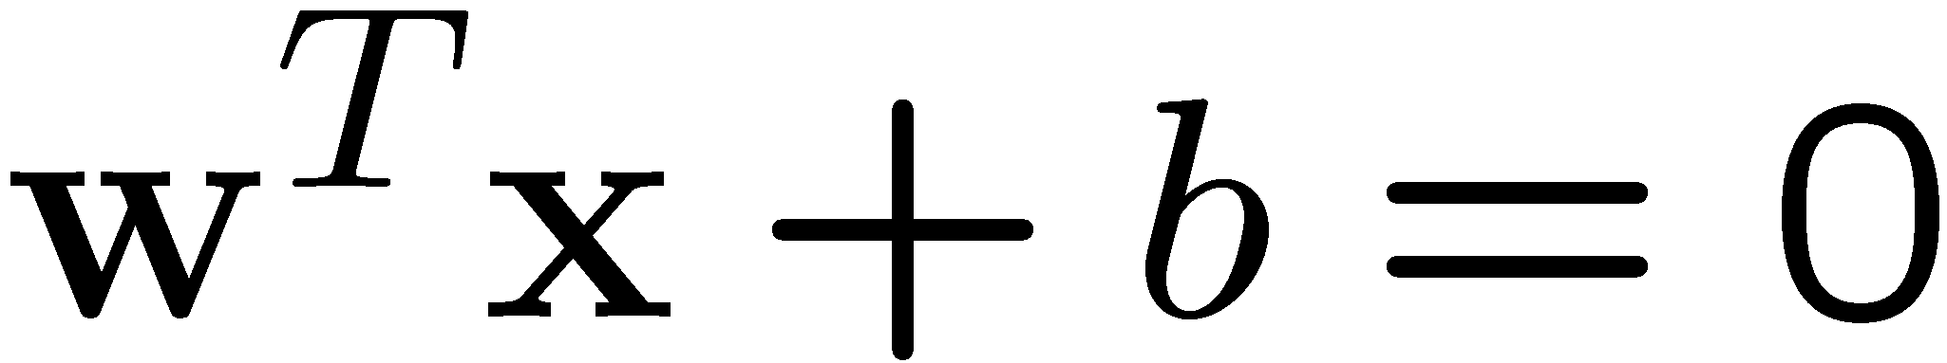
Large-margin Decision Boundary
The decision boundary should be as far away from the data of both classes as possible
  We should maximize the margin, m
  Distance between the origin and the line w^{t}x=k is k/||w||
Class 2
m
Class 1

Slide 11
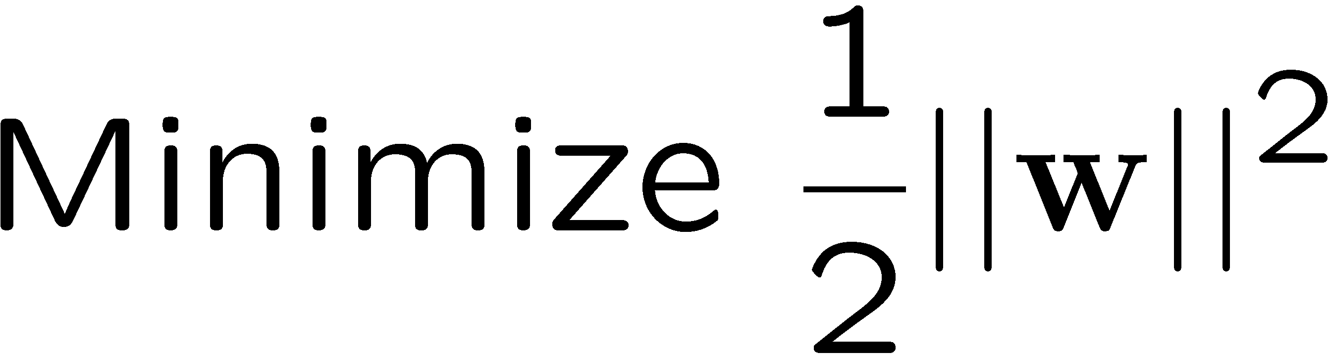
Finding the Decision Boundary
Let {x₁, ..., x_{n}} be our data set and let y_{i} ∈ {1,-1} be the class label of x_{i}
The decision boundary should classify all points correctly ⇒
The decision boundary can be found by solving the following constrained optimization problem
This is a constrained optimization problem. Solving it requires some new tools

Slide 12
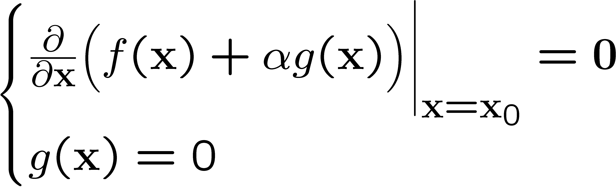
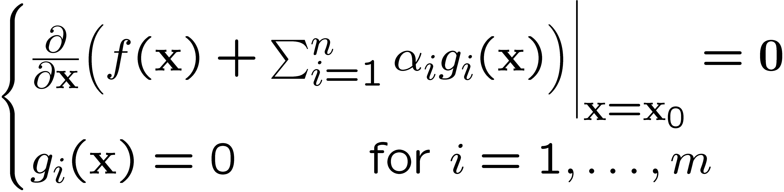
Recap of Constrained Optimization
Suppose we want to: minimize f(x) subject to g(x) = 0
A necessary condition for x₀ to be a solution:
α: the Lagrange multiplier
For multiple constraints g_{i}(x) = 0, i=1, …, m, we need a Lagrange multiplier α_{i} for each of the constraints

Slide 13
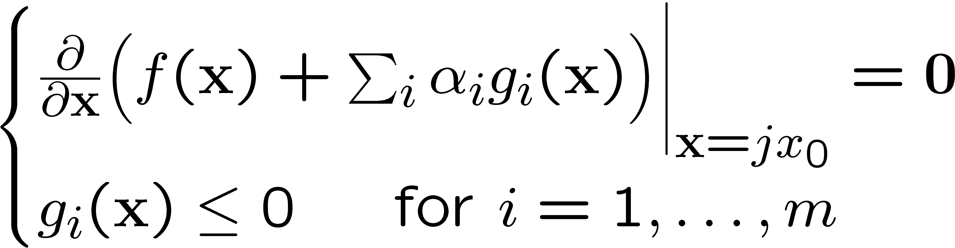
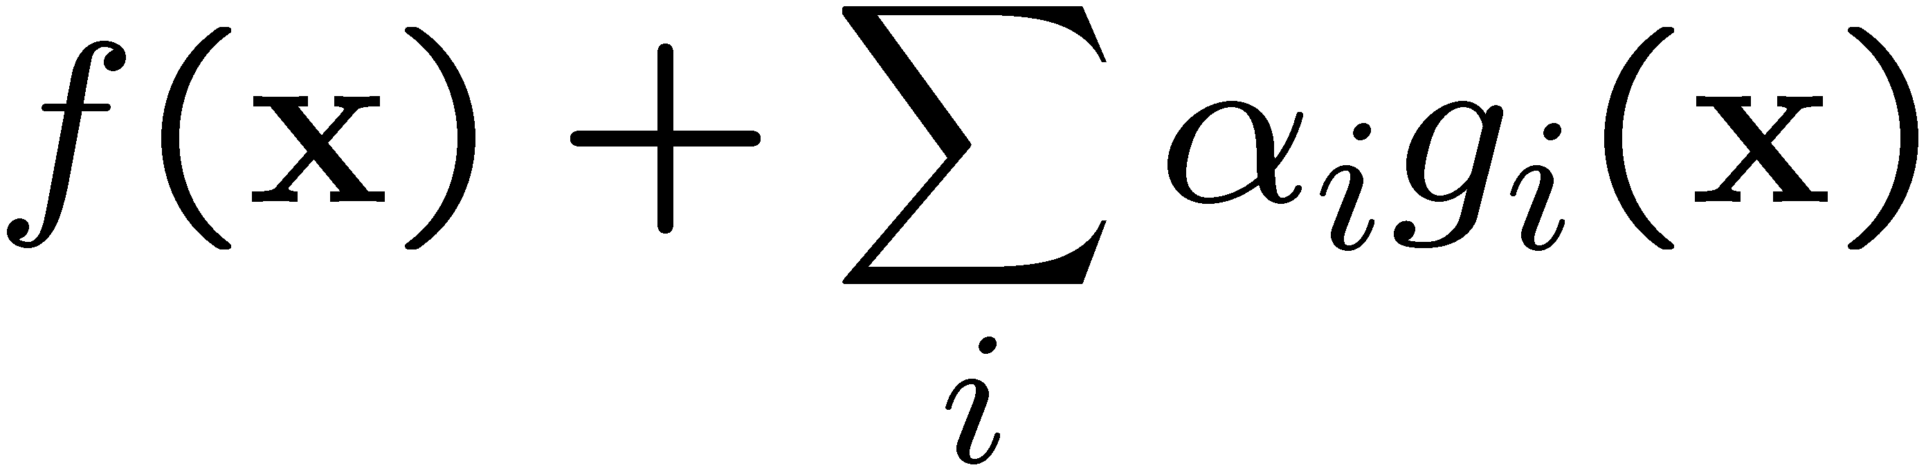
Recap of Constrained Optimization
The case for inequality constraint g_{i}(x)≤0 is similar, except that the Lagrange multiplier α_{i} should be positive
If x₀ is a solution to the constrained optimization problem
There must exist α_{i}≥0 for i=1, …, m such that x₀ satisfy
The function is also known as the Lagrangrian; we want to set its gradient to 0

Slide 14
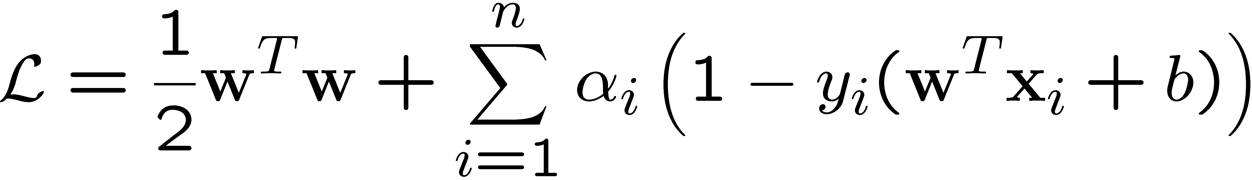
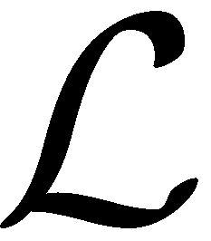
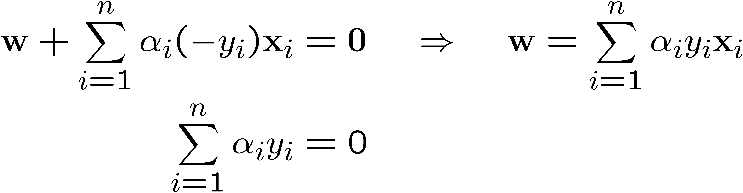
Back to the Original Problem
The Lagrangian is
  Note that ||w||² = w^{T}w
Setting the gradient of w.r.t. w and b to zero, we have

Slide 15
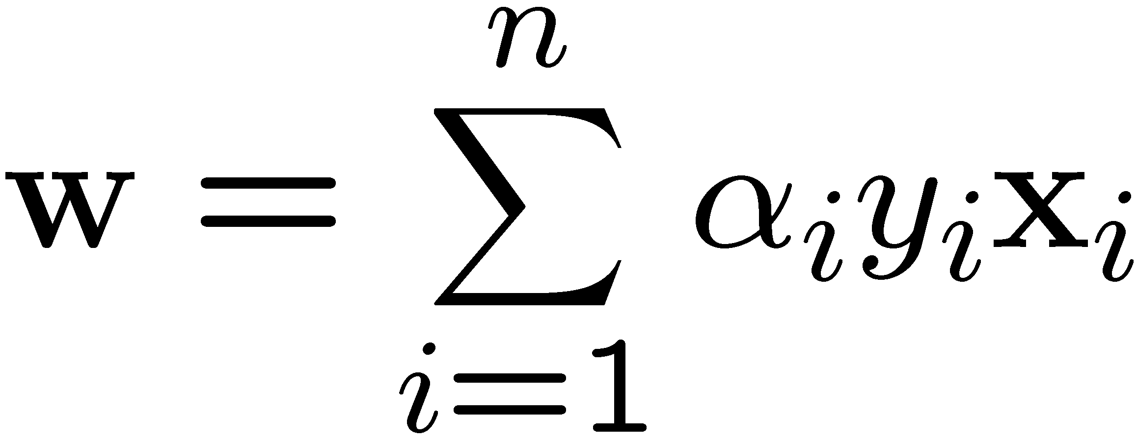
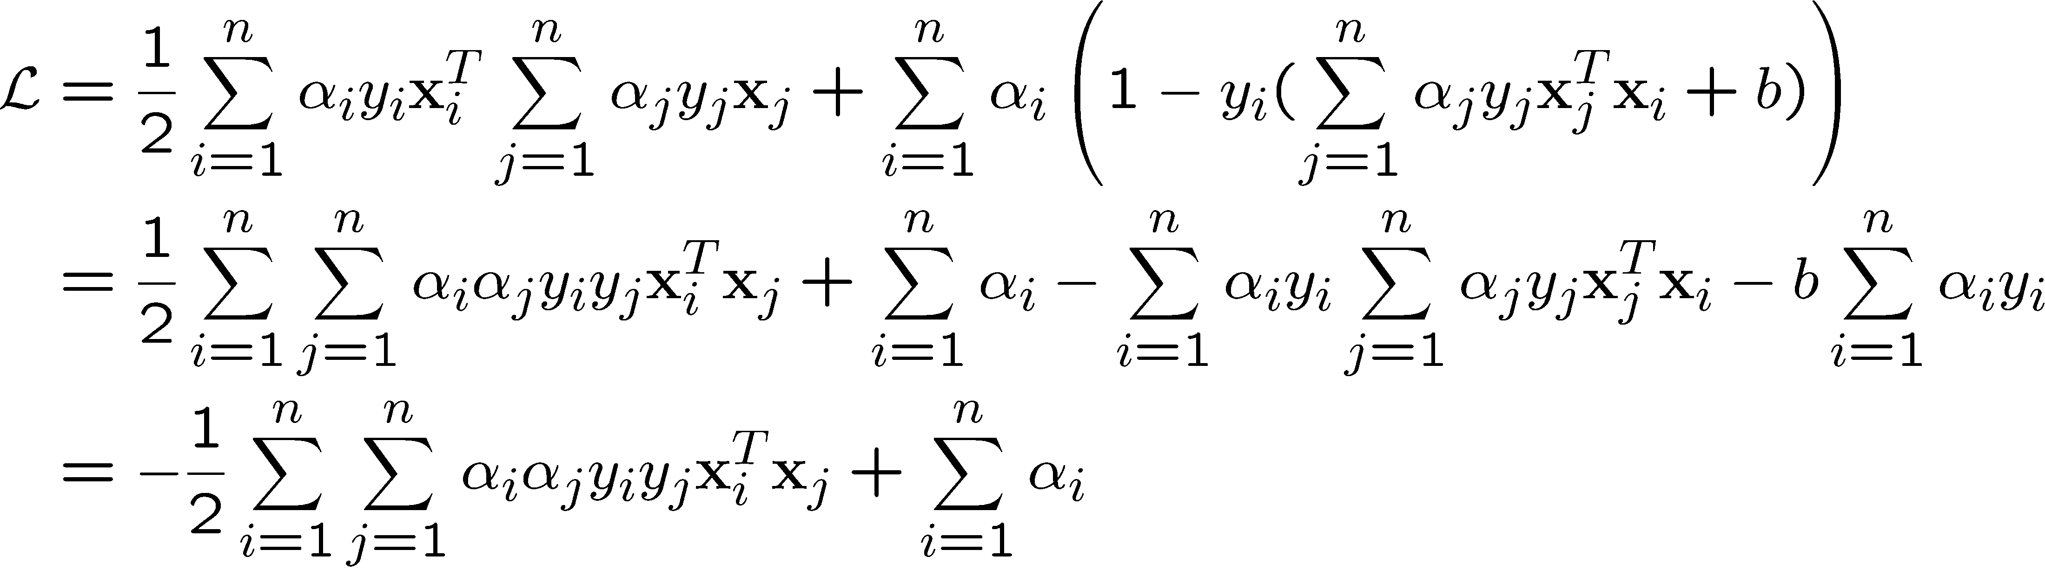
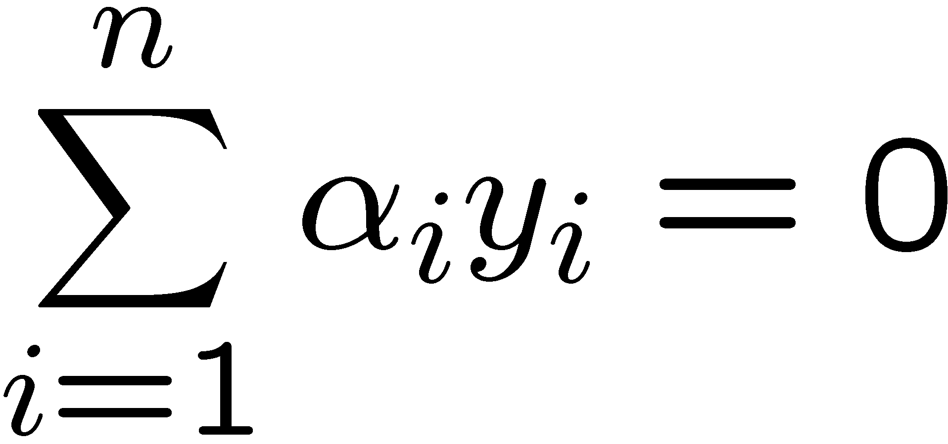
The Dual Problem
If we substitute to , we have
Note that
This is a function of α_{i} only
Ready for the kernel trick!

Slide 16
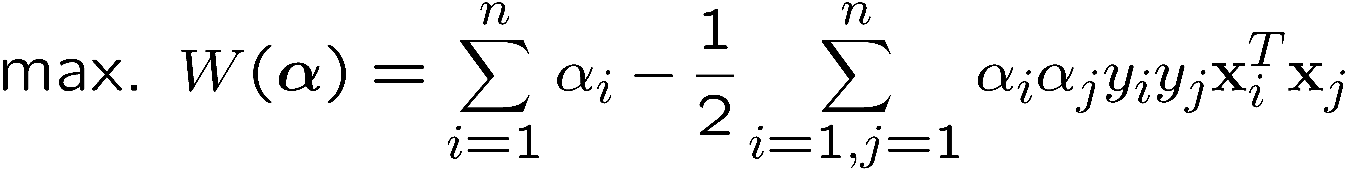
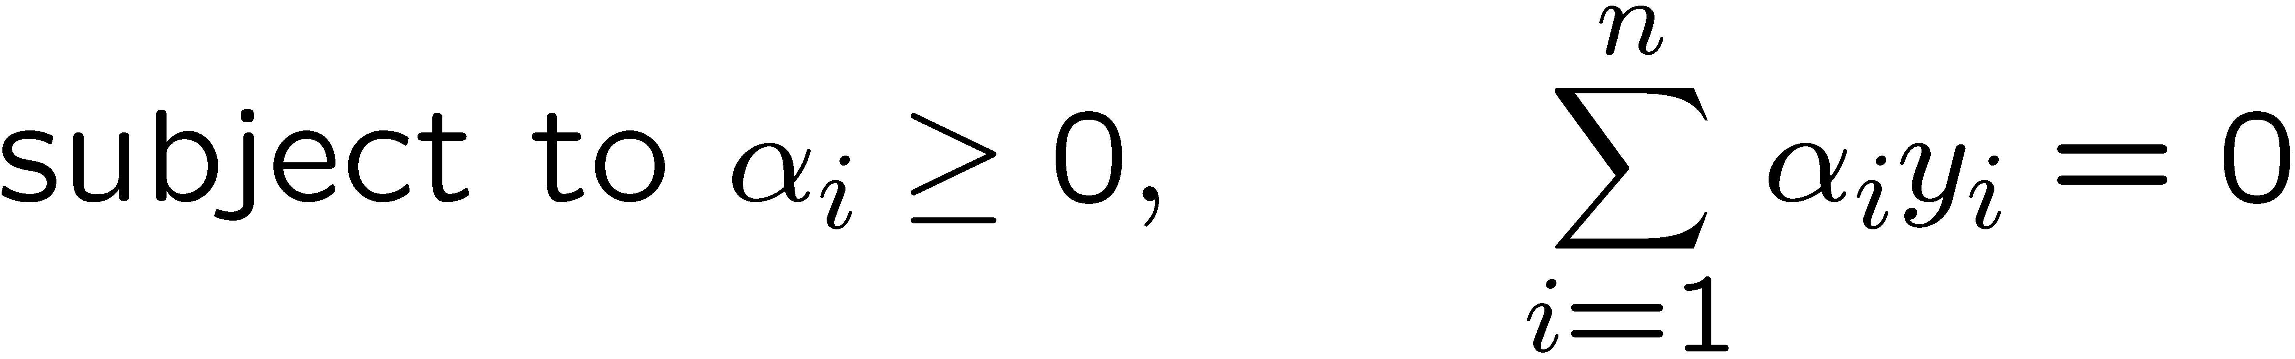
The Dual Problem
The new objective function is in terms of α_{i} only
It is known as the dual problem: if we know w, we know all α_{i}; if we know all α_{i}, we know w
The original problem is known as the primal problem
The objective function of the dual problem needs to be maximized!
The dual problem is therefore:
Properties of α_{i} when we introduce the Lagrange multipliers
The result when we differentiate the original Lagrangian w.r.t. b

Slide 17
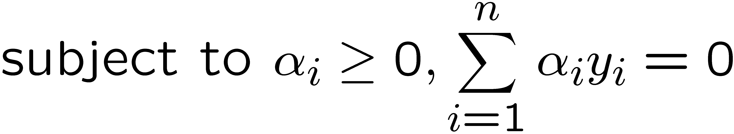

The Dual Problem
This is a quadratic programming (QP) problem
  A global maximum of α_{i} can always be found
w can be recovered by
Notes:
Let x(1) and x(-1) be two S.V.
Then b = -1/2( w^T x(1) + w^T x(-1) )

Slide 18
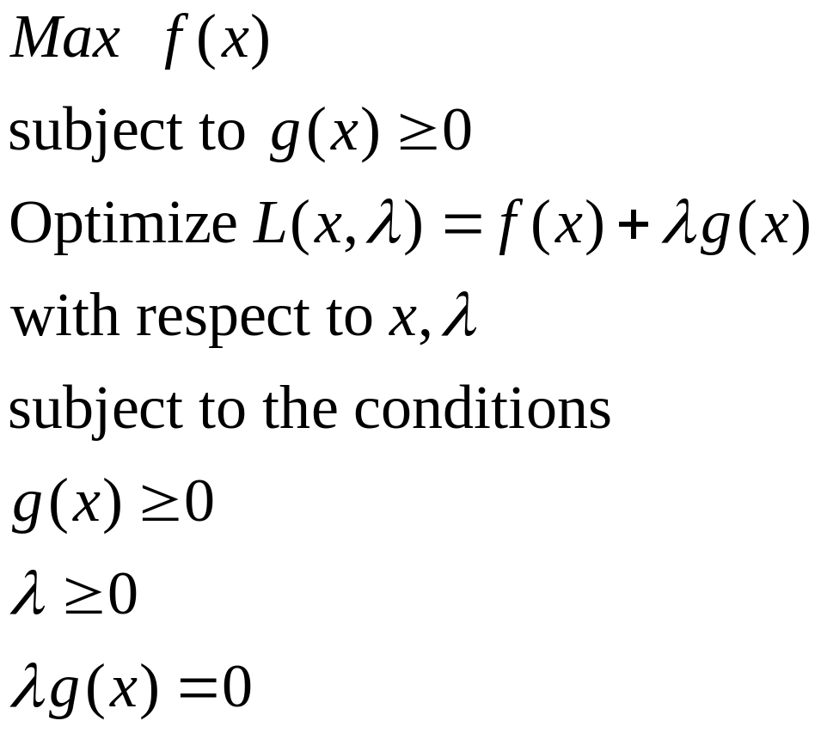
Karush-Kuhn-Tucker conditions
Karush-Kuhn-Tucker conditions

Slide 19
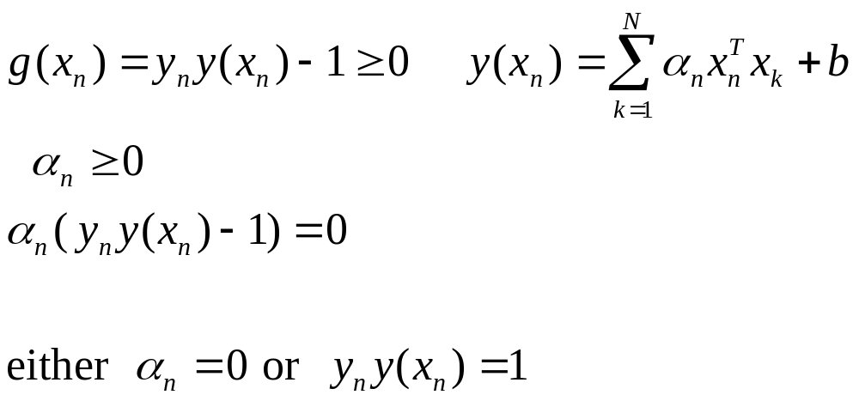

For our problem
Points that push against the margin (support vectors) – the only ones with
Any other point (not a support vector)

Slide 20
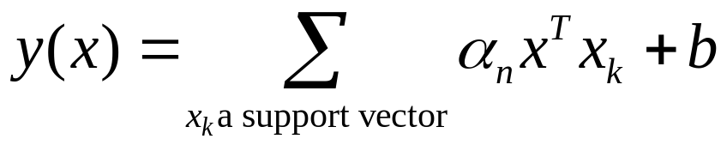
Consequently…
The only points with positive Lagrange coefficients are support vectors
The other points play no role (they don’t add anything to the evaluation)
You only need to retain support vectors, once the model is trained! (Huge savings!)

Slide 21
The Quadratic Programming Problem
Many approaches have been proposed
  Loqo, cplex, etc. (see http://www.numerical.rl.ac.uk/qp/qp.html)
Most are “interior-point” methods
  Start with an initial solution that can violate the constraints
  Improve this solution by optimizing the objective function and/or reducing the amount of constraint violation
For SVM, sequential minimal optimization (SMO) seems to be the most popular
  A QP with two variables is trivial to solve
  Each iteration of SMO picks a pair of (α_{i},α_{j}) and solve the QP with these two variables; repeat until convergence
In practice, we can just regard the QP solver as a “black-box” without bothering how it works

Slide 22
A Geometrical Interpretation
Class 2
α₁₀=0
α₈=0.6
α₇=0
α₂=0
α₅=0
α₁=0.8
α₄=0
α₆=1.4
α₉=0
α₃=0
Class 1
Notes:
So, if change internal points, no effect on the decision boundary

Slide 23
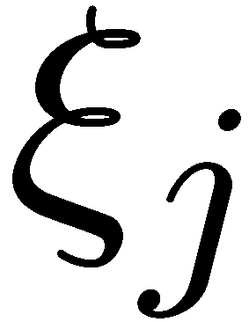
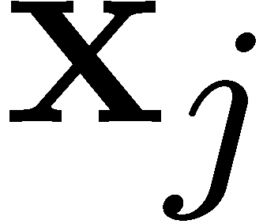
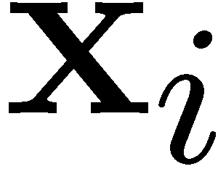
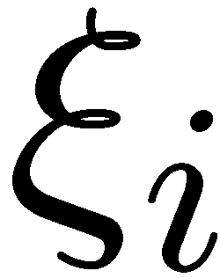
Overlapping: Non-linearly Separable Problems
We allow “error” ξ_{i} in classification; it is based on the output of the discriminant function w^{T}x+b
ξ_{i} approximates the number of misclassified samples
Class 2
Class 1

Slide 24
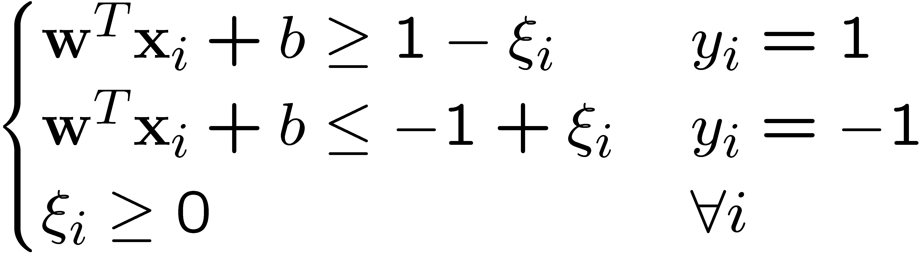
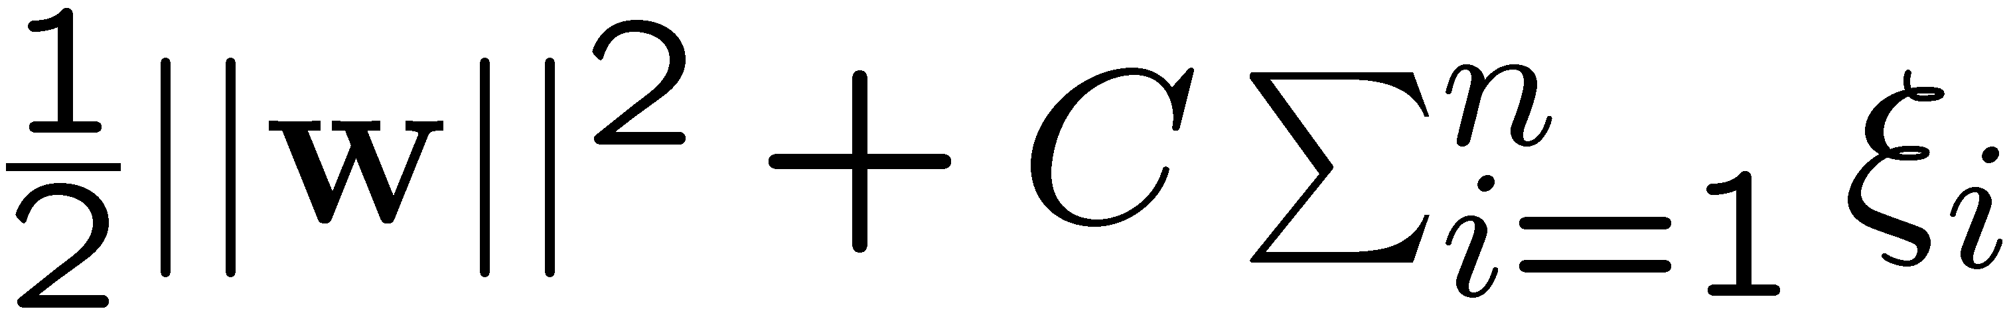
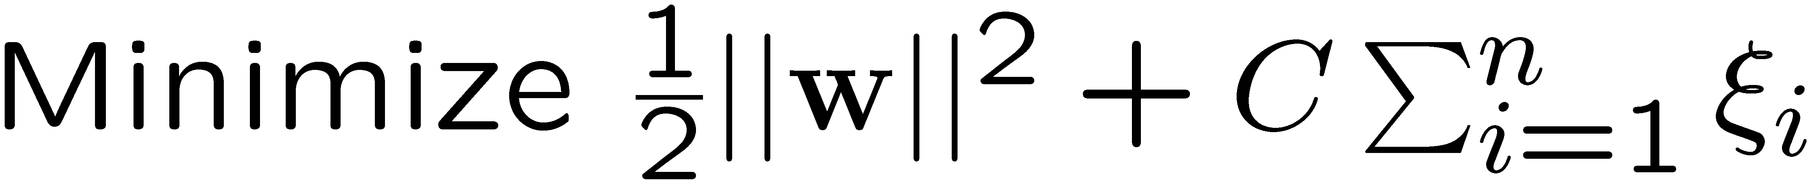
Soft Margin Hyperplane
If we minimize ∑_{i}ξ_{i}, ξ_{i} can be computed by
  ξ_{i} are “slack variables” in optimization
  Note that ξ_{i}=0 if there is no error for x_{i}
  ξ_{i} is an upper bound of the number of errors
We want to minimize
  C : tradeoff parameter between error and margin
The optimization problem becomes

Slide 25
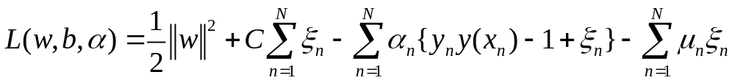
Lagrangian (Primal problem)

Slide 26
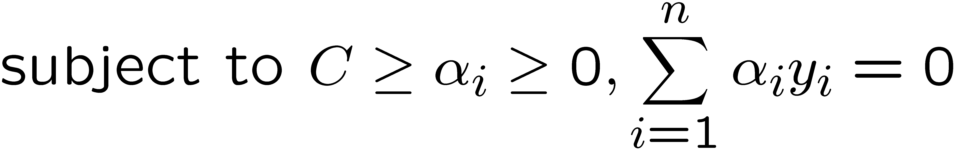
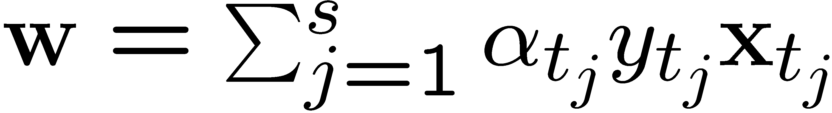
The Optimization Problem
The dual of this new constrained optimization problem is
w is recovered as
This is very similar to the optimization problem in the linear separable case, except that there is an upper bound C on α_{i} now
Once again, a QP solver can be used to find α_{i}
Notes:
Note also, everything is done by inner-products

Slide 27
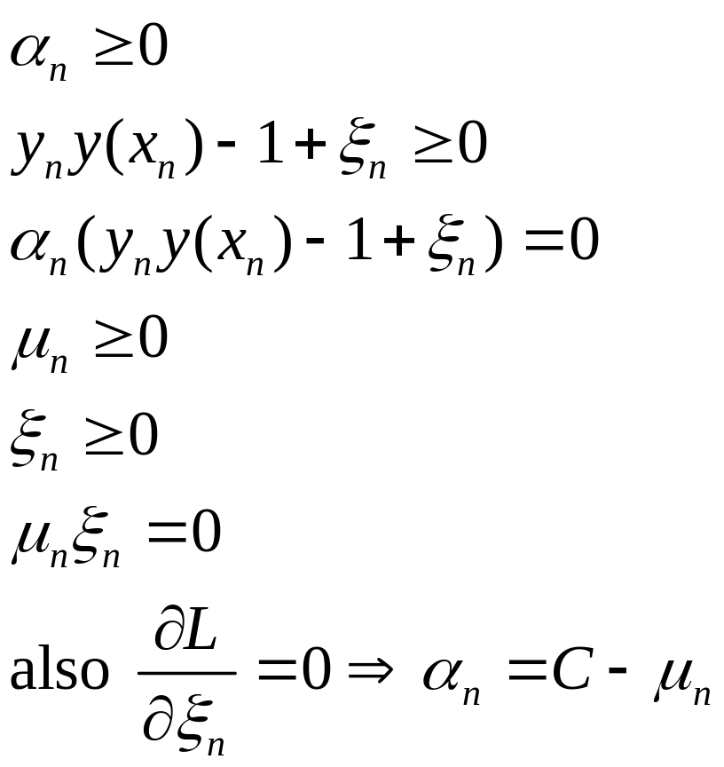


KKT conditions
Only support vectors have positive alphas (discard the rest!)
KKT
If
then the point is on the margin!
Else
The point is inside the margin

Slide 28
Extension to Non-linear Decision Boundary
So far, we have only considered large-margin classifier with a linear decision boundary
How to generalize it to become nonlinear?
Key idea: transform x_{i} to a higher dimensional space to “make life easier”
  Input space: the space the point x_{i} are located
  Feature space: the space of φ(x_{i}) after transformation
Why transform?
  Linear operation in the feature space is equivalent to non-linear operation in input space
  Classification can become easier with a proper transformation. In the XOR problem, for example, adding a new feature of x₁x₂ make the problem linearly separable
Notes:
XOR: x_1, x_2, and we want to transform to x_1^2, x_2^2, x_1 x_2
It can also be viewed as feature extraction from the feature vector x, but now we extract more feature than the number of features in x.

Slide 29
Transforming the Data
φ( )
φ( )
φ( )
φ( )
φ( )
φ(.)
φ( )
φ( )
φ( )
φ( )
φ( )
φ( )
φ( )
φ( )
φ( )
φ( )
φ( )
φ( )
φ( )
Input space
Feature space
Note: feature space is of higher dimension than the input space in practice
Computation in the feature space can be costly because it is high dimensional
  The feature space can be infinite-dimensional!
The kernel trick comes to rescue

Slide 30
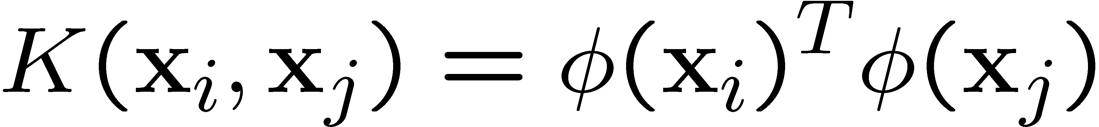
The Kernel Trick
Recall the SVM optimization problem
The data points only appear as inner product
As long as we can calculate the inner product in the feature space, we do not need the mapping explicitly
Many common geometric operations (angles, distances) can be expressed by inner products
Define the kernel function K by

Slide 31
An Example for φ(.) and K(.,.)
Suppose φ(.) is given as follows
An inner product in the feature space is
So, if we define the kernel function as follows, there is no need to carry out φ(.) explicitly
This use of kernel function to avoid carrying out φ(.) explicitly is known as the kernel trick

Slide 32
Kernel Functions
In practical use of SVM, the user specifies the kernel function; the transformation φ(.) is not explicitly stated
Given a kernel function K(x_{i}, x_{j}), the transformation φ(.) is given by its eigenfunctions (a concept in functional analysis)
  Eigenfunctions can be difficult to construct explicitly
  This is why people only specify the kernel function without worrying about the exact transformation
Another view: kernel function, being an inner product, is really a similarity measure between the objects

Slide 33
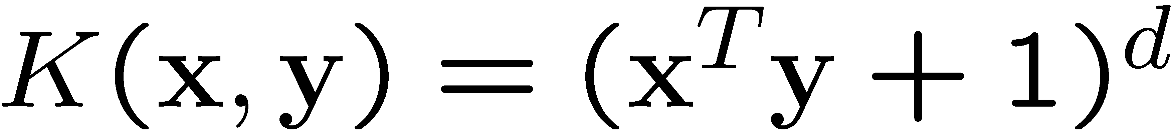
Examples of Kernel Functions
Polynomial kernel with degree d
Radial basis function kernel with width σ
  Closely related to radial basis function neural networks
  The feature space is infinite-dimensional
Sigmoid with parameter κ and θ
  It does not satisfy the Mercer condition on all κ and θ
Notes:
Despite violating Mercer condition, the sigmoid kernel function can still work

Slide 34
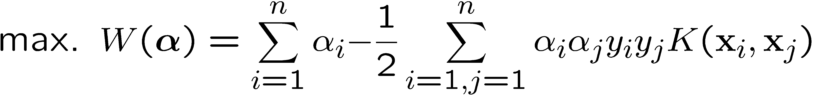
Modification Due to Kernel Function
Change all inner products to kernel functions
For training,
Original
With kernel function

Slide 35
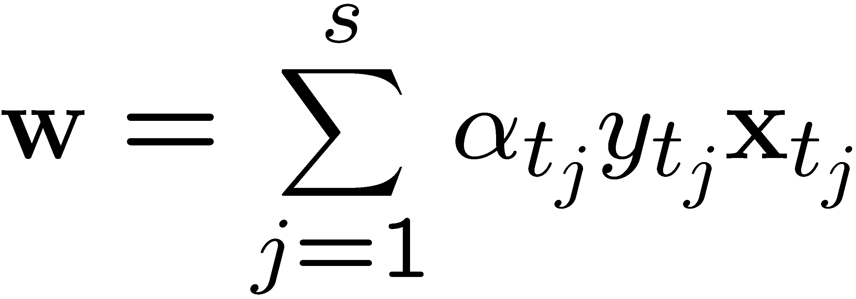
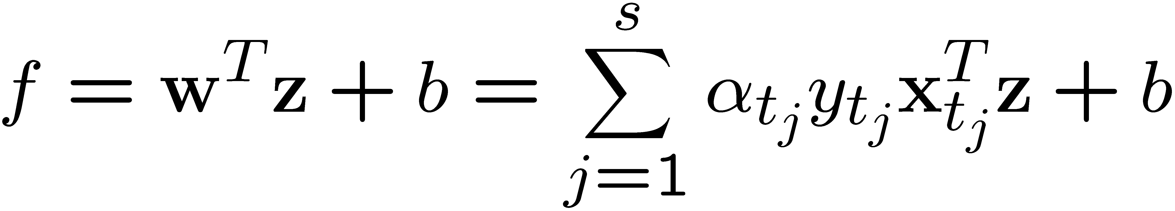
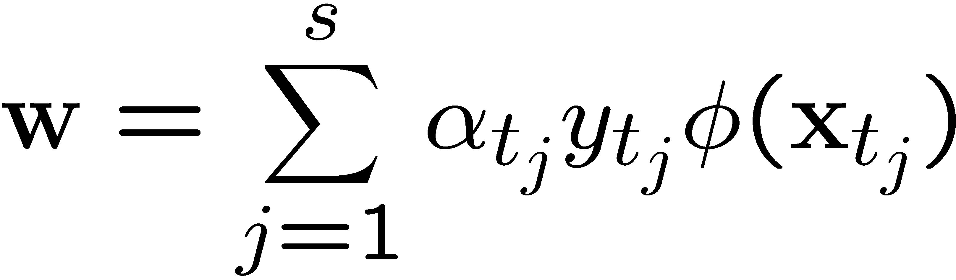
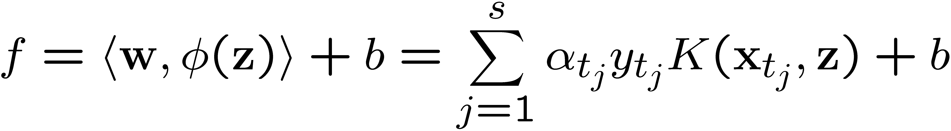
Modification Due to Kernel Function
For evaluation, the new data z is classified as class 1 if f ≥0, and as class 2 if f <0
Original
With kernel function

Slide 36
The parameter C for non-linear SVMs
Perfect separation of training data can, in general be achieved in the enlarged feature space F
Such perfect separation is actually bad: it leads to the danger of overfitting the data. Then the classifier will generalize poorly.
A proper setting of C allows to avoid overfitting

Slide 37
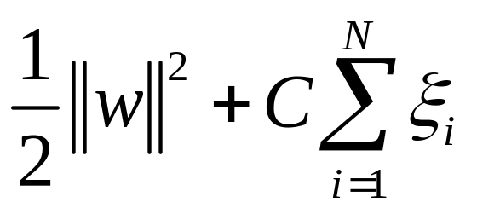

C in non-linear SVMs
Let’s look once again at the objective function
C is the penalty for errors of misclassification
  Large C: discourages any positive parameters ⇒ tendency to overfit the data ⇒highly complicated boundaries in input space
  Small C: encourages a small value of ||w|| ⇒ larger margin ⇒more data on the wrong side of the margin ⇒ smoother decision boundary in input space
  In practice: tune C to achieve best performance

Slide 38
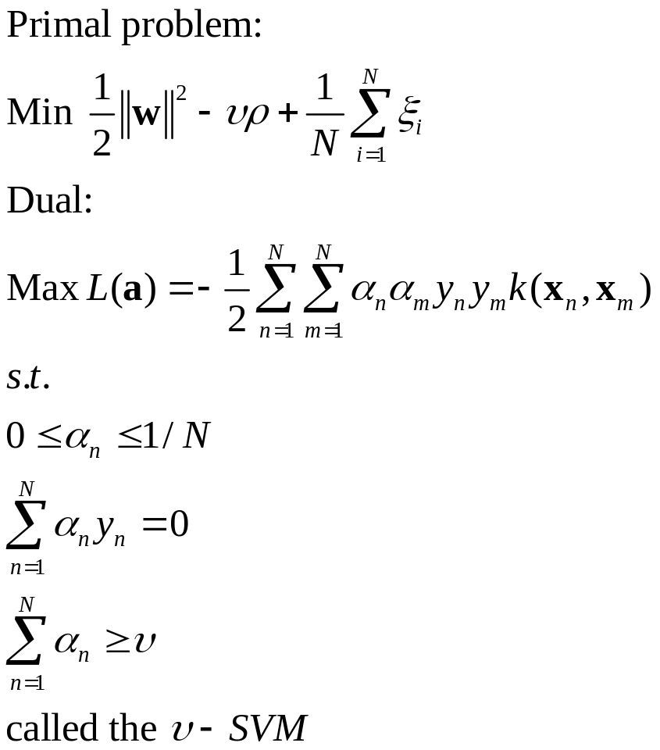
Alternative formulation of soft margin problems
Due to Schölkopf et al
Lower bound on the fraction of support vectors
Upper bound on the fraction of margin errors

Slide 39
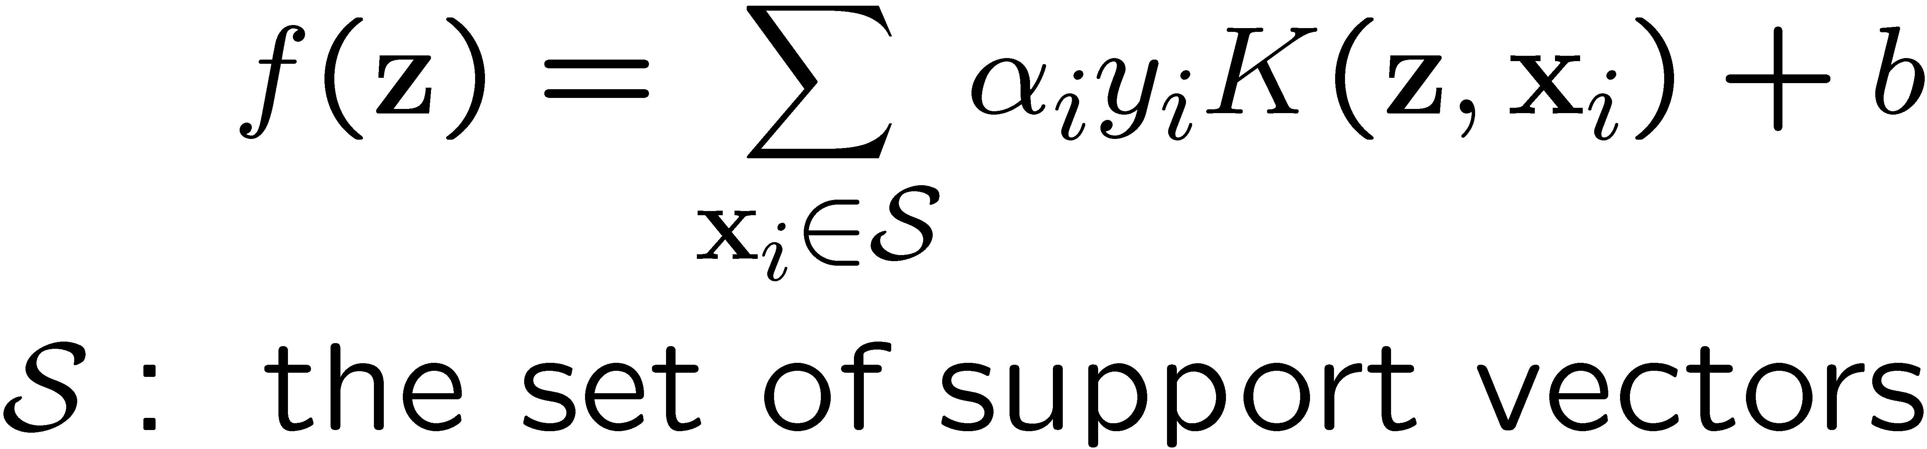
More on Kernel Functions
Since the training of SVM only requires the value of K(x_{i}, x_{j}), there is no restriction of the form of x_{i} and x_{j}
  x_{i} can be a sequence or a tree, instead of a feature vector
K(x_{i}, x_{j}) is just a similarity measure comparing x_{i} and x_{j}
For a test object z, the discriminat function essentially is a weighted sum of the similarity between z and a pre-selected set of objects (the support vectors)

Slide 40
More on Kernel Functions
Not all similarity measures can be used as kernel function, however
  The kernel function needs to satisfy the Mercer function, i.e., the function is “positive-definite”
  This implies that the n by n kernel matrix, in which the (i,j)-th entry is the K(x_{i}, x_{j}), is always positive definite
  This also means that the QP is convex and can be solved in polynomial time

Slide 41
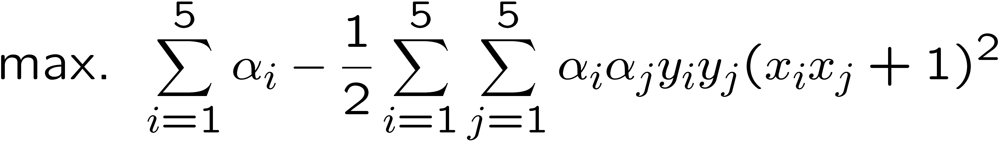
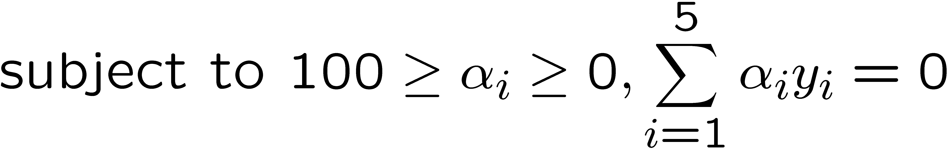
Example
Suppose we have 5 1D data points
  x₁=1, x₂=2, x₃=4, x₄=5, x₅=6, with 1, 2, 6 as class 1 and 4, 5 as class 2 ⇒ y₁=1, y₂=1, y₃=-1, y₄=-1, y₅=1
We use the polynomial kernel of degree 2
  K(x,y) = (xy+1)²
  C is set to 100
We first find α_{i} (i=1, …, 5) by
Notes:
H =
4 9 -25 -36 49
9 25 -81 -121 169
-25 -81 289 441 -625
-36 -121 441 676 -961
49 169 -625 -961 1369

Slide 42
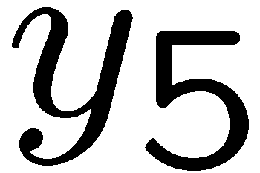
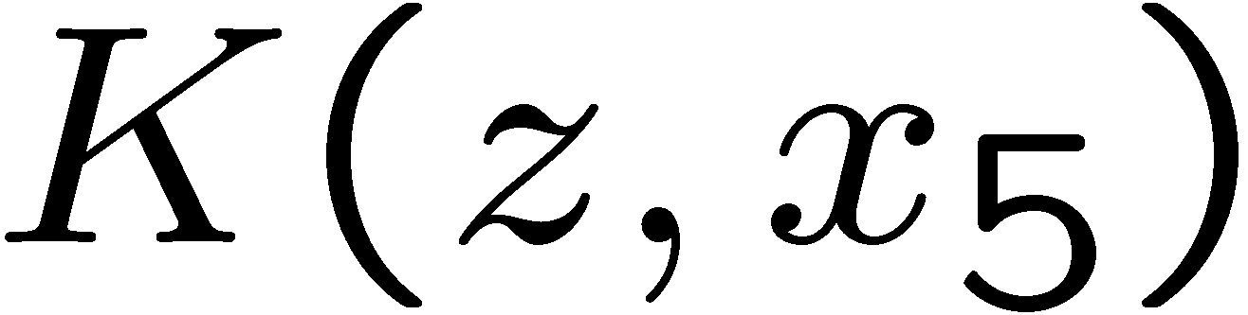
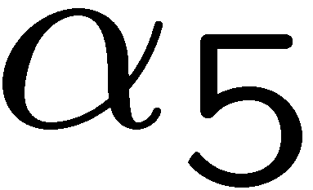
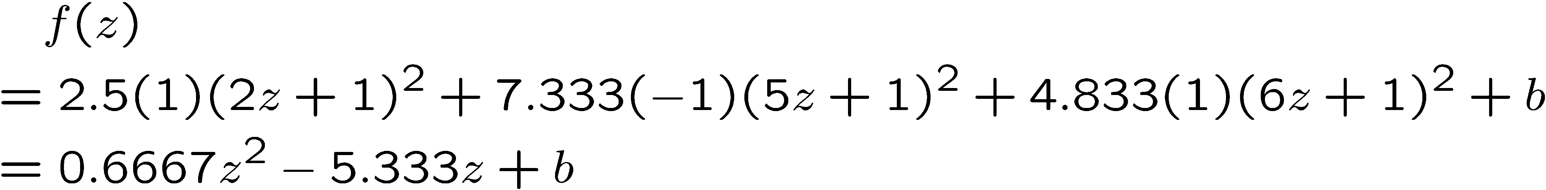
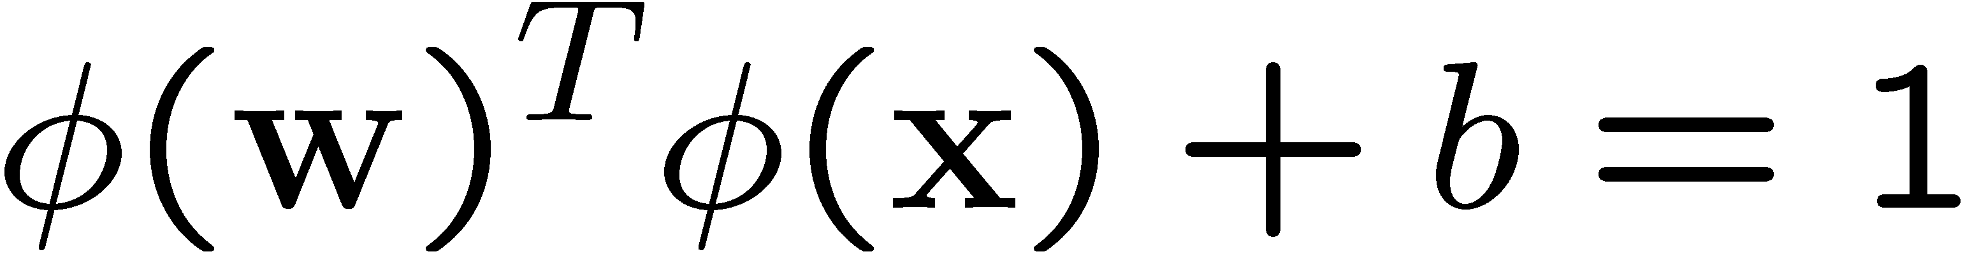
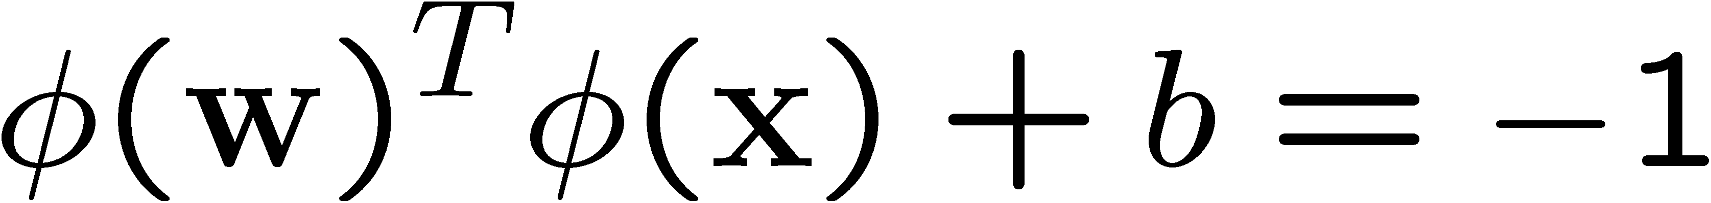
Example
By using a QP solver, we get
  α₁=0, α₂=2.5, α₃=0, α₄=7.333, α₅=4.833
  Note that the constraints are indeed satisfied
  The support vectors are {x₂=2, x₄=5, x₅=6}
The discriminant function is
b is recovered by solving f(2)=1 or by f(5)=-1 or by f(6)=1, as x₂ and x₅ lie on the line
and x₄ lies on the line
All three give b=9
Notes:
The optimization toolbox of matlab contains a quadratic programming solver

Slide 43
Example
Value of discriminant function
class 1
class 2
class 1
1
2
4
5
6

Slide 44

Nonlinear Kernel (I)

Slide 45

Nonlinear Kernel (II)

Slide 46

Why SVM Work?
The feature space is often very high dimensional. Why don’t we have the curse of dimensionality?
A classifier in a high-dimensional space has many parameters and is hard to estimate
Vapnik argues that the fundamental problem is not the number of parameters to be estimated. Rather, the problem is about the flexibility of a classifier
Typically, a classifier with many parameters is very flexible, but there are also exceptions
  Let x_{i}=10^{i} where i ranges from 1 to n. The classifier
  can classify all x_{i} correctly for all possible combination of class labels on x_{i}
  This 1-parameter classifier is very flexible

Slide 47
Why SVM works?
Vapnik argues that the flexibility of a classifier should not be characterized by the number of parameters, but by the flexibility (capacity) of a classifier
  This is formalized by the “VC-dimension” of a classifier
Consider a linear classifier in two-dimensional space
If we have three training data points, no matter how those points are labeled, we can classify them perfectly
Notes:
Another view. When you fit splines (for example), a large ||w|| corresponds to a “rough” decision boundaries.

Slide 48
VC-dimension
However, if we have four points, we can find a labeling such that the linear classifier fails to be perfect
We can see that 3 is the critical number
The VC-dimension of a linear classifier in a 2D space is 3 because, if we have 3 points in the training set, perfect classification is always possible irrespective of the labeling, whereas for 4 points, perfect classification can be impossible

Slide 49
VC-dimension
The VC-dimension of the nearest neighbor classifier is infinity, because no matter how many points you have, you get perfect classification on training data
The higher the VC-dimension, the more flexible a classifier is
VC-dimension, however, is a theoretical concept; the VC-dimension of most classifiers, in practice, is difficult to be computed exactly
  Qualitatively, if we think a classifier is flexible, it probably has a high VC-dimension

Slide 50
Structural Risk Minimization (SRM)
A fancy term, but it simply means: we should find a classifier that minimizes the sum of training error (empirical risk) and a term that is a function of the flexibility of the classifier (model complexity)
Recall the concept of confidence interval (CI)
  For example, we are 99% confident that the population mean lies in the 99% CI estimated from a sample
We can also construct a CI for the generalization error (error on the test set)

Slide 51
Structural Risk Minimization (SRM)
Increasing
error rate
Training error
Training error
CI of test error for classifier 2
CI of test error for classifier 1
SRM prefers classifier 2 although it has a higher training error, because the upper limit of CI is smaller

Slide 52
Structural Risk Minimization (SRM)
It can be proved that the more flexible a classifier, the “wider” the CI is
The width can be upper-bounded by a function of the VC-dimension of the classifier
In practice, the confidence interval of the testing error contains [0,1] and hence is trivial
  Empirically, minimizing the upper bound is still useful
The two classifiers are often “nested”, i.e., one classifier is a special case of the other
SVM can be viewed as implementing SRM because ∑_{i} ξ_{i} approximates the training error; ½||w||² is related to the VC-dimension of the resulting classifier
See http://www.svms.org/srm/ for more details

Slide 53
Justification of SVM
Large margin classifier
SRM
Ridge regression: the term ½||w||² “shrinks” the parameters towards zero to avoid overfitting
The term the term ½||w||² can also be viewed as imposing a weight-decay prior on the weight vector, and we find the MAP estimate

Slide 54
Choosing the Kernel Function
Probably the most tricky part of using SVM.
The kernel function is important because it creates the kernel matrix, which summarizes all the data
Many principles have been proposed (diffusion kernel, Fisher kernel, string kernel, …)
There is even research to estimate the kernel matrix from available information
In practice, a low degree polynomial kernel or RBF kernel with a reasonable width is a good initial try
Note that SVM with RBF kernel is closely related to RBF neural networks, with the centers of the radial basis functions automatically chosen for SVM

Slide 55
Other Aspects of SVM
How to use SVM for multi-class classification?
  One can change the QP formulation to become multi-class
  More often, multiple binary classifiers are combined
    See DHS 5.2.2 for some discussion
  One can train multiple one-versus-all classifiers, or combine multiple pairwise classifiers “intelligently”
How to interpret the SVM discriminant function value as probability?
  By performing logistic regression on the SVM output of a set of data (validation set) that is not used for training
Some SVM software (like libsvm) have these features built-in

Slide 56
Software
A list of SVM implementation can be found at http://www.kernel-machines.org/software.html
Some implementation (such as LIBSVM) can handle multi-class classification
SVMLight is among one of the earliest implementation of SVM
Several Matlab toolboxes for SVM are also available

Slide 57
Summary: Steps for Classification
Prepare the pattern matrix
Select the kernel function to use
Select the parameter of the kernel function and the value of C
  You can use the values suggested by the SVM software, or you can set apart a validation set to determine the values of the parameter
Execute the training algorithm and obtain the α_{i}
Unseen data can be classified using the α_{i} and the support vectors

Slide 58
Strengths and Weaknesses of SVM
Strengths
  Training is relatively easy
    No local optimal, unlike in neural networks
  It scales relatively well to high dimensional data
  Tradeoff between classifier complexity and error can be controlled explicitly
  Non-traditional data like strings and trees can be used as input to SVM, instead of feature vectors
Weaknesses
  Need to choose a “good” kernel function.

Slide 59
Other Types of Kernel Methods
A lesson learnt in SVM: a linear algorithm in the feature space is equivalent to a non-linear algorithm in the input space
Standard linear algorithms can be generalized to its non-linear version by going to the feature space
  Kernel principal component analysis, kernel independent component analysis, kernel canonical correlation analysis, kernel k-means, 1-class SVM are some examples

Slide 60
Epsilon Support Vector Regression
(ε-SVR)
Linear regression in feature space
Unlike in least square regression, the error function is ε-insensitive loss function
  Intuitively, mistake less than ε is ignored
  This leads to sparsity similar to SVM
ε-insensitive loss function
Square loss function
Penalty
Penalty
Value off
target
Value off
target
−ε
ε

Slide 61


Epsilon Support Vector Regression
(ε-SVR)
Given: a data set {x₁, ..., x_{n}} with target values {u₁, ..., u_{n}}, we want to do ε-SVR
The optimization problem is
Similar to SVM, this can be solved as a quadratic programming problem

Slide 62

Epsilon Support Vector Regression
(ε-SVR)
C is a parameter to control the amount of influence of the error
The ½||w||² term serves as controlling the complexity of the regression function
  This is similar to ridge regression
After training (solving the QP), we get values of α_{i} and α_{i}*, which are both zero if x_{i} does not contribute to the error function
For a new data z,

